Slide 1
Airport Retail
Group 4

Slide 2
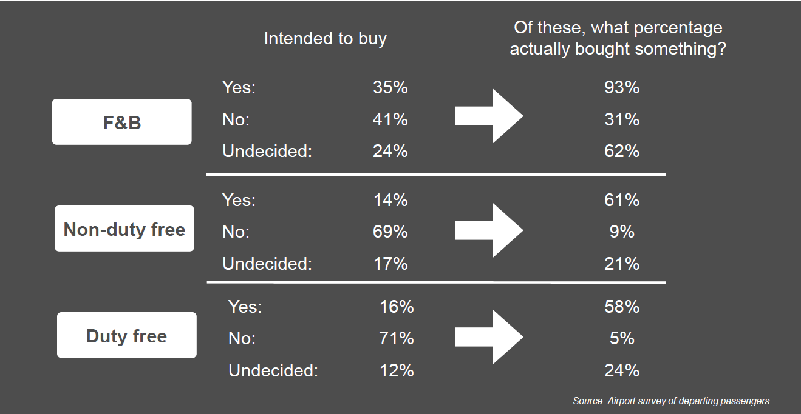
Passenger Survey
Passenger Survey

Slide 3
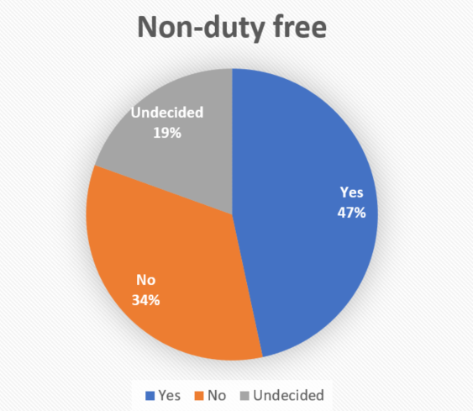
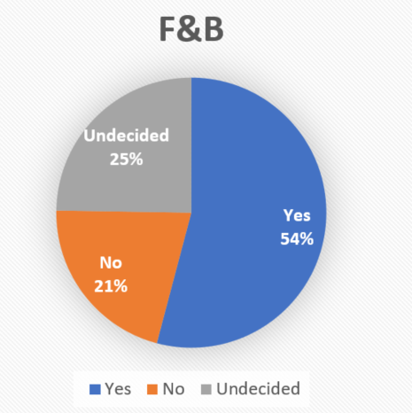
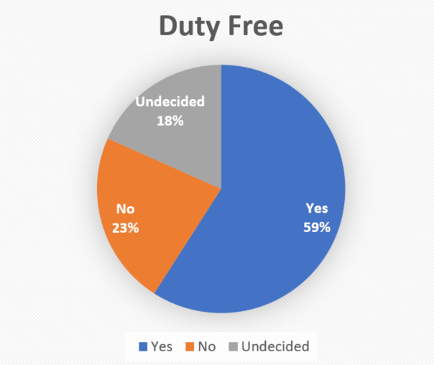
Methodology
Conditional Probability and Bayes' theorem
Calculate the intention (Yes/No/Undecided) of the people who eventually bought at airport based on different good categories

Slide 4
Insights
“Duty free” and “Non-duty free” are much more elastic market compared with “F&B” since the “No” proportion is much greater than the “Undecided” proportion.
The proportion of “No” plus “Undecided” indicates how good the sales promotion and advertisement of airport shops is.
The “Non-duty free” category is the easiest category airport can improve their sale performance.

Slide 5
SWOT Analysis
Strengths
- Almost 24/7 year-round foot traffic
-Nature of airports encourages spending
-Nature of airports allows for high prices
Weaknesses
-On the learning curve /
Largely Undocumented
-Very dependent on
unpredictable political climate
-High competition
Opportunities
-Continued market
development
-Emerging countries e.g.
Japan, Brazil, China, Russia
-Digitalization
Threats
-Online stores threaten
physical stores
-Alternatives to car parking
-Shrinking middle class
-Population aging

Slide 6
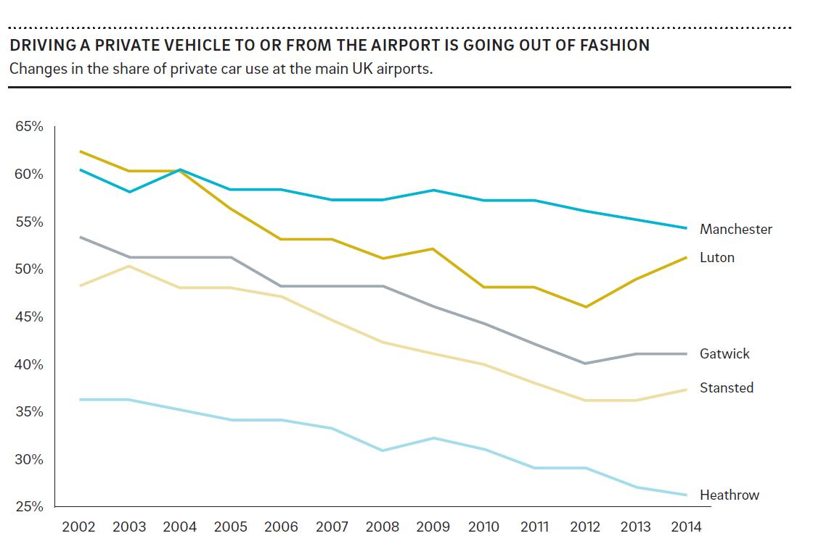
Airport Carparking
Alternatives to private cars e.g. Lyft, Uber
Ever increasing accessibility through public transport expansion
Hotel shuttle services
Electric cars remedy the decline partially
Introduction of self driving that can return home
Very tough competition e.g. FlightCar
High cost

Slide 7
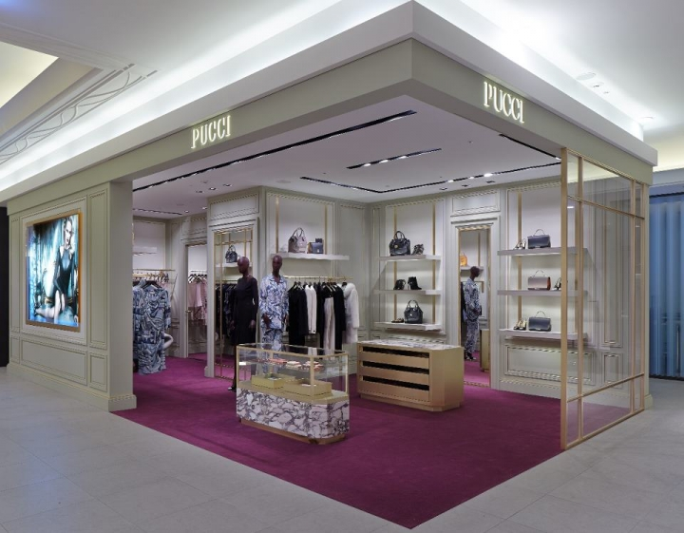
Shopping at the Airport
Airport Spending is Transforming
Challenges and Demanding Customers
China Online Retail 66% in 2012
Millennials are interested in the experience not the product
Online-retail is taking over, airport retail needs to adapt
Suggestion: Order
online & pick up at
airport option
2-5 B EUR lost in revenue in the next 5 years
Available items do not meet expectations e.g. high demand for compact and local items
low customer
satisfaction 40%
intending customers do
not buy with not finding
what they want as the #1
stated reason
Decline in the purchase of alcohol and tobacco due to regulations
Economic crisis in the
EU affects spending

Slide 8
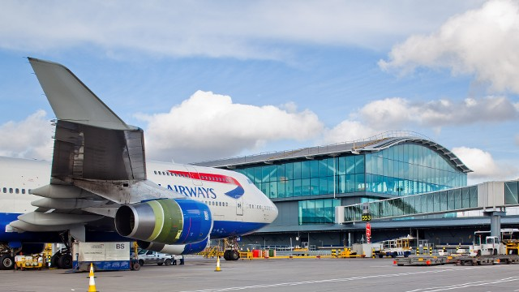
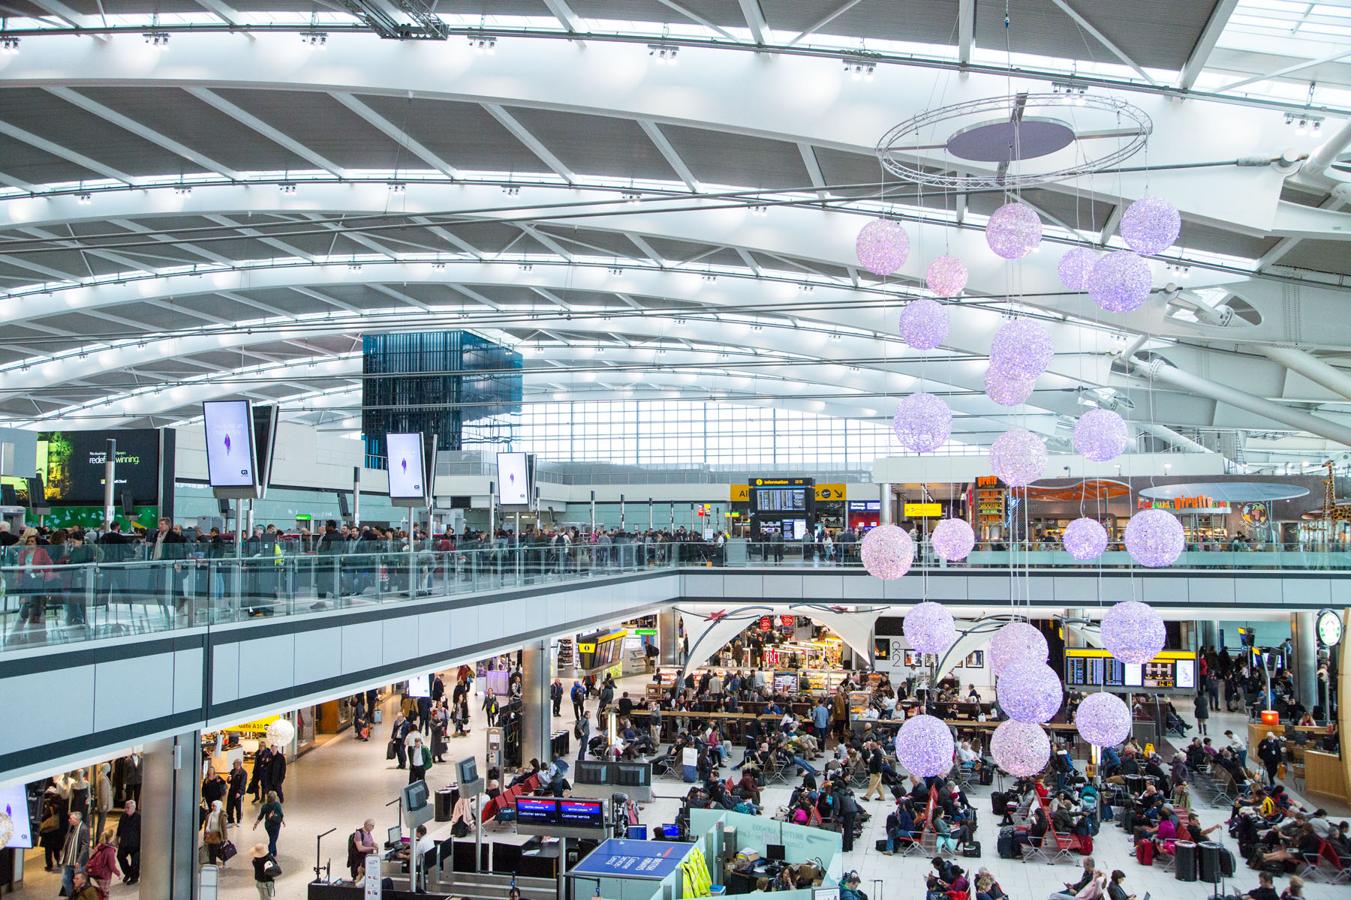
London Heathrow
185 000 passengers passing through each day
4 terminals
420 000 ft² of total retail space
More than 300 shops

Slide 9
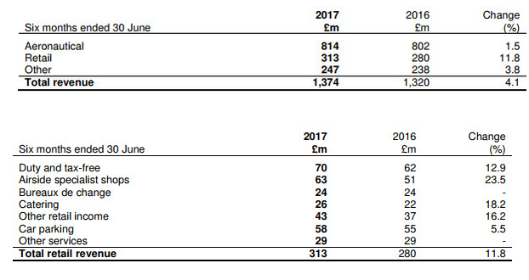
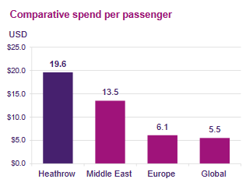
London Heathrow
-> 22.7 % of airport income comes from retail in 2017

Slide 10
Conclusion
Offering good shopping & dining experience
In F&B, ensure that customers are given multiple brands and varied menu choices.
Enrich the choice of shops & products.
Mass customization: Tailor-made projects adapted to each zone’s clientele
Motivating the interest in purchase before arrival
Widen our targets of customers
There is much room for growth in the area of online shopping, and souvenir food items. iShopChangi, the airport’s online shopping platform.
A concession business model:
Joint ventures 50/50, or Brands operating directly their shop.
Airport play the double role: lessor and shareholder, which can be reactive and share the finical and legal risk, lower the cost.

Slide 11
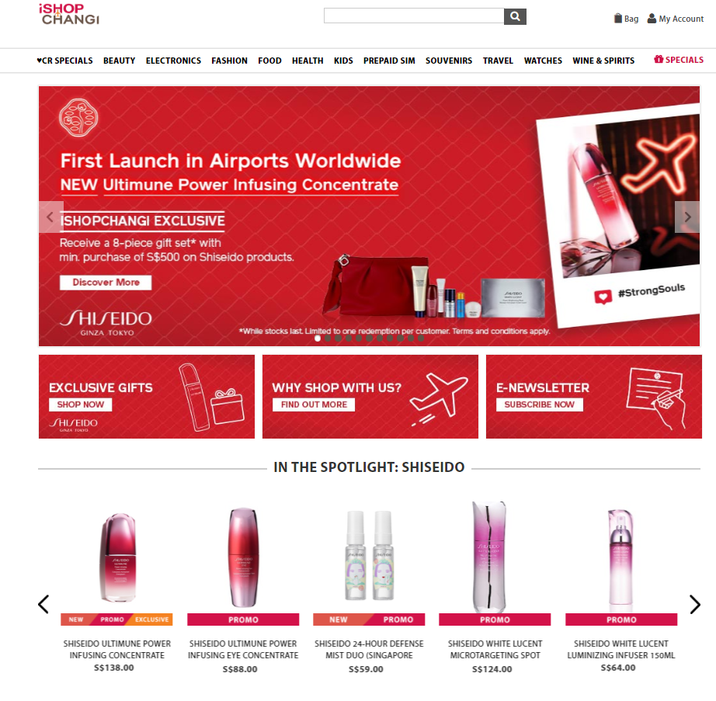
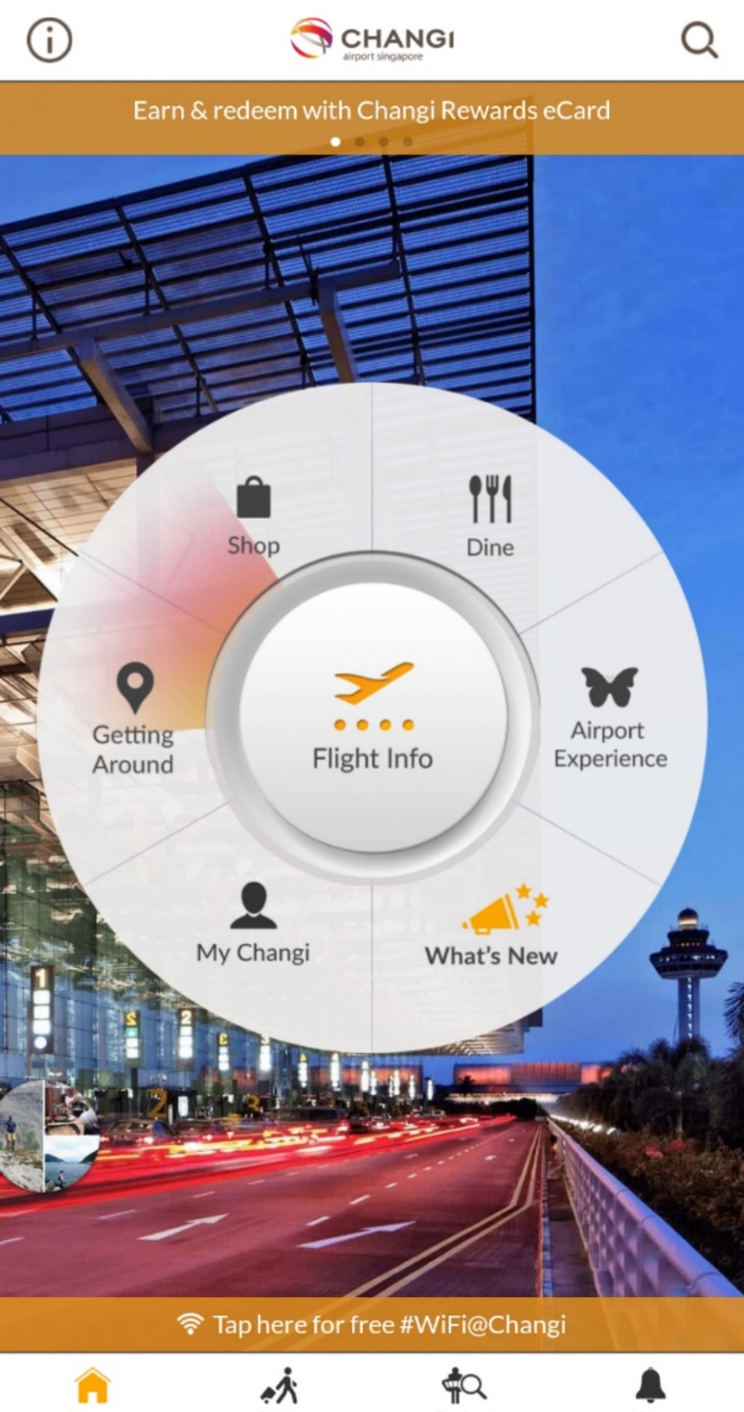
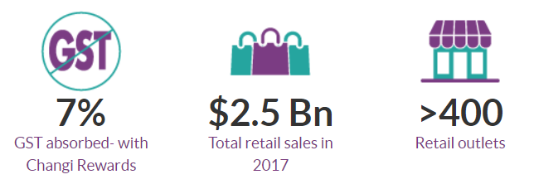
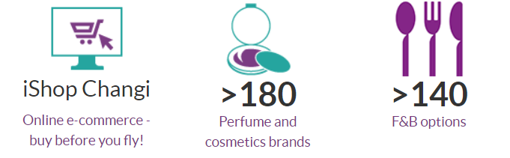
Singapore Changi Airport
iShopChangi’s value proposition is simple, and its results speak for itself – sales on the platform had increased by some 76% year-on-year
Data is from official website of Changi Airport: http://www.changiairport.com

Slide 12
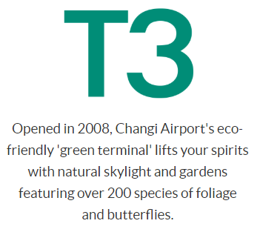
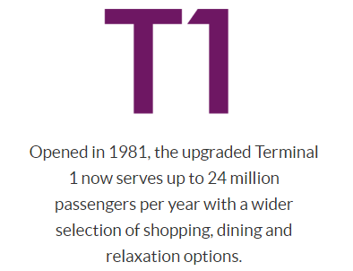
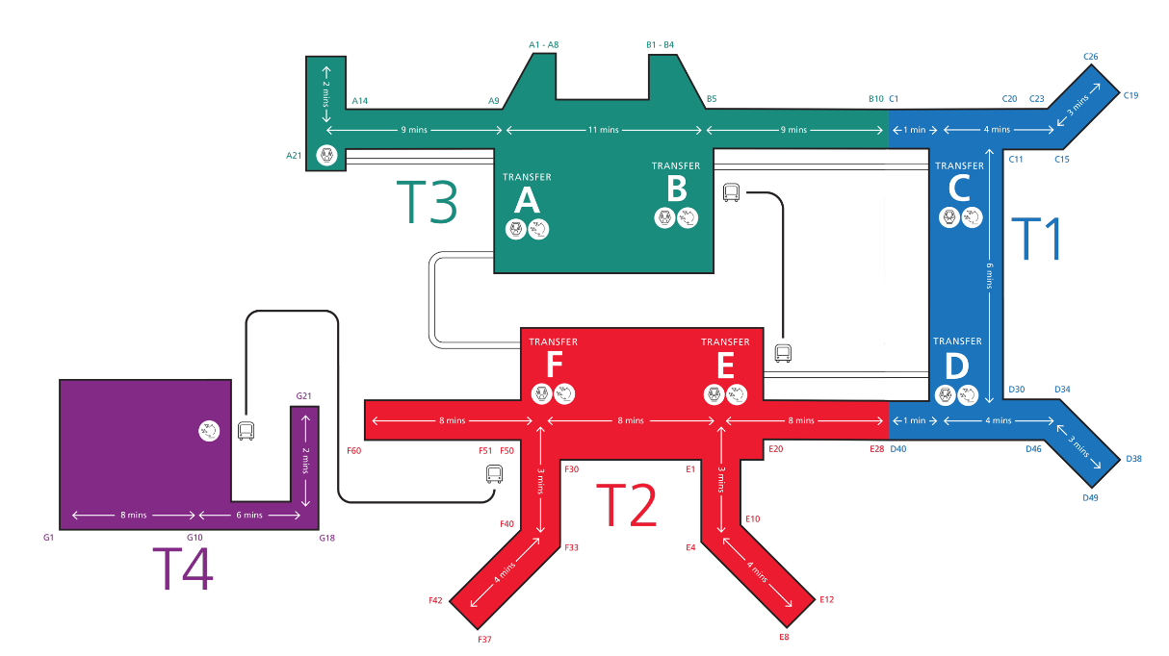
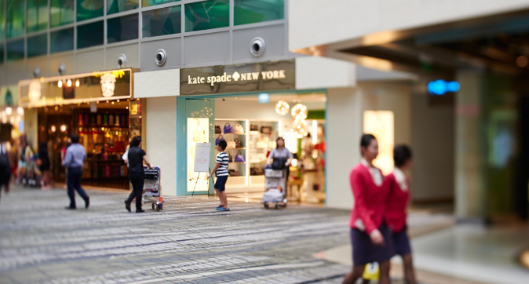
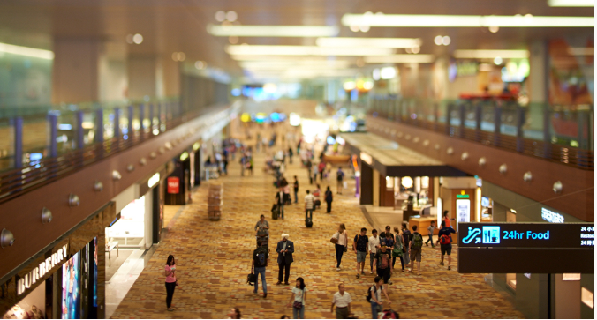
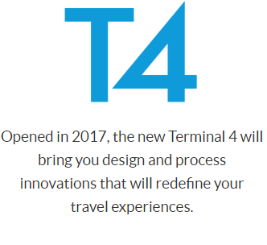
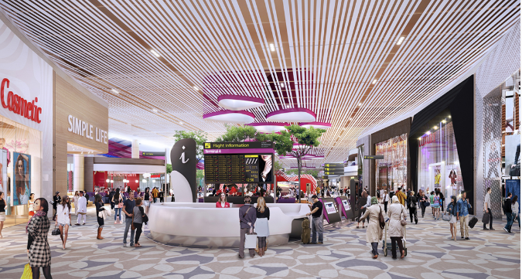
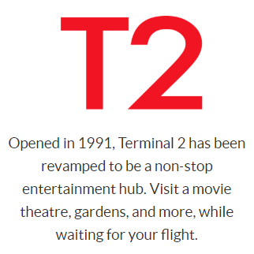
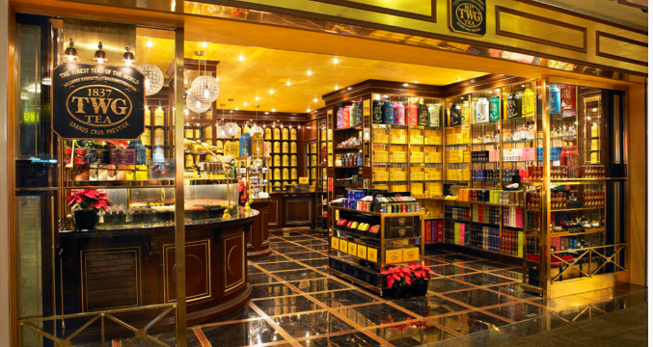
Conclusion

